Slide 1
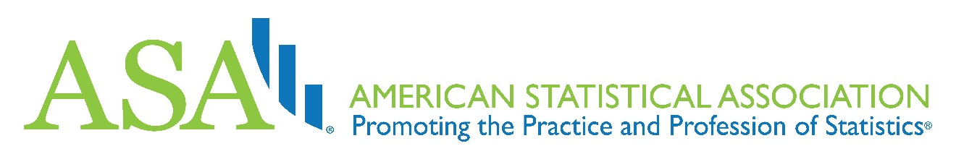
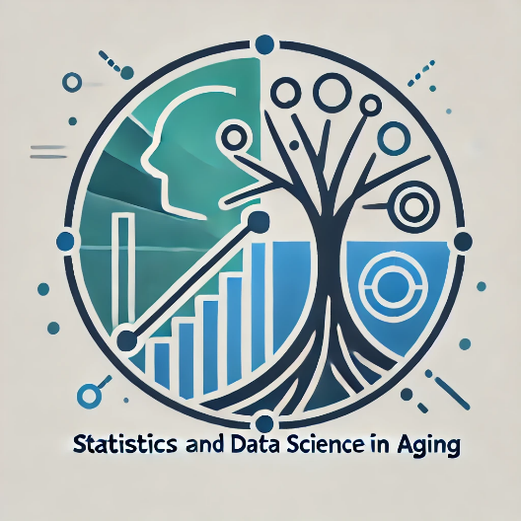
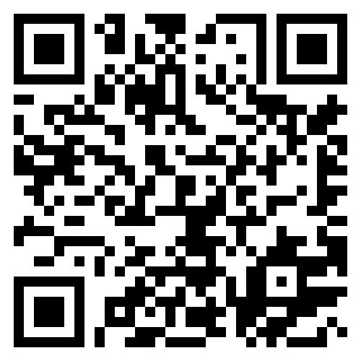
Statistics and Data Science in Aging Interest Group
The American Statistical Association Statistics and Data Science in Aging Interest Group is a new Interest Group open to anyone interested in statistics and data science and their applications in aging research.
One does not have to be a member of the American Statistical Association to be a member of the Interest Group. There are no dues for membership, but we do accept contributions.
Our charter's objectives:
To serve as the primary group at ASA for furthering methodological and substantive activity in statistics and data science related to aging research.
To partner with other organizations to further such research.
To partner with other interest groups, and with sections and chapters, of the American Statistical Association, to further such activity.
To gather statisticians, data scientists, and other aging researchers to provide a platform for sharing expertise and experiences.
To sponsor educational activities consistent with the interests of the members of the Interest Group.
Please join us!
We have an active webinar program and meetups at conferences, with more to come!

